Slide 1
Deoxyribonucleic acid or DNA
The molecule that controls everything that happens in the cell.
DNA contains the genetic code or commands that direct the activities of cells and ultimately, the body.
DNA is present in all living things from bacteria to animals. In animals, it is found in almost all cell types, except red blood cells.
DNA found within a nucleus in the cells.
In order to extract DNA it’s necessary to denature and break down the cells to release DNA from these cells.

Slide 2
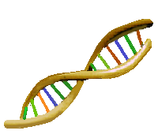
Introduction:
The three main parts of the cell are :
The nucleus, which holds DNA,
The cell membrane, which surrounds and protects the cell,
The cytoplasm, which is the jelly-like part of the cell between the membrane and the nucleus.

Slide 3
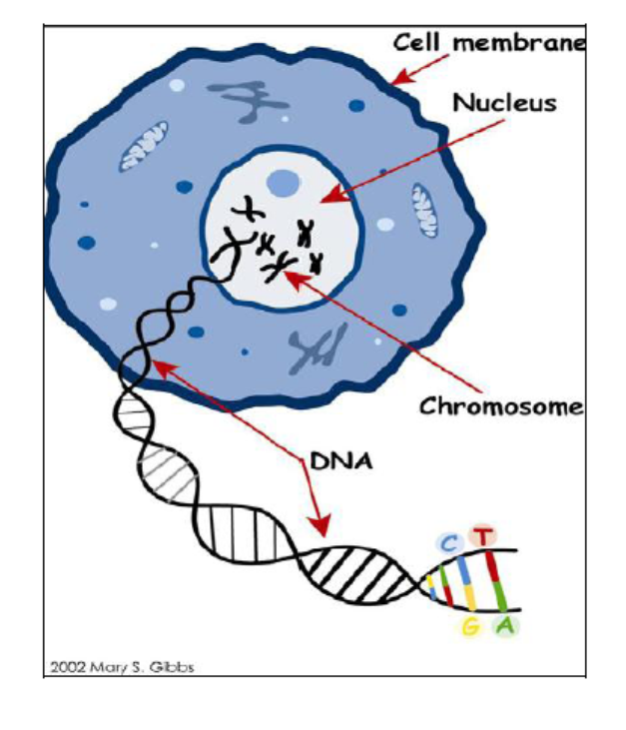
To Extract the dna we need
The basic aim:
To destroy cell membrane
To destroy the nucleus
To remove Protein
To collect DNA
To preserve DNA from breaking down

Slide 4
Fun Experiment ☺ ☺
DNA Extraction from …
Can we extract DNA in our HOME!!
YESSSSS ☺

Slide 5
Is DNA in My Food???
DNA is present in the cells of all living organisms.
The process of extracting DNA from a cell is the first step for many laboratory procedures in biotechnology.
The scientist must be able to separate DNA from the unwanted substances of the cell gently enough so that the DNA does not denature (break up).

Slide 6
DNA Facts
Each cell contains 9 feet of DNA
In an average meal, you EAT approximately 55,000,000 cells
This is equal to approximately 93,205 miles of DNA

Slide 7
DNA
DNA is found in the nucleus of all eukaryotic cells
Most cells have the diploid 2n chromosome number
Many plants are polyploid (contain several sets of chromosomes)
Strawberries are octaploid 8n

Slide 8
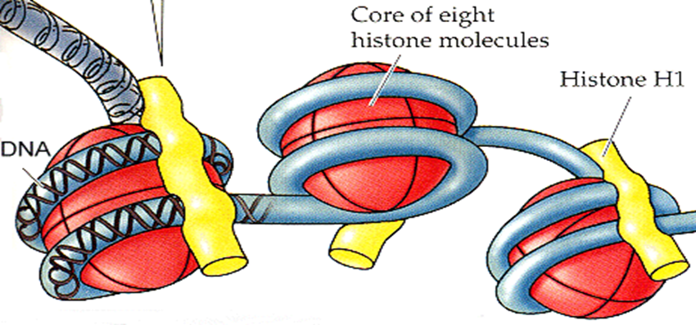
DNA
DNA is enclosed in a nuclear and a cell membrane made of phospholipids
DNA is also coiled around proteins (hisones)
Both the phospholipid layer and the proteins must be removed to see DNA

Slide 9
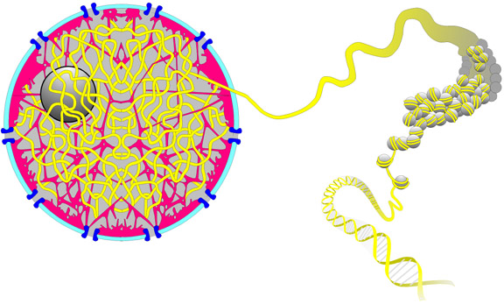
NUCLEUS with DNA

Slide 10
To Extract DNA, You Must Remove …
Cell membrane
Cytoplasm
Nuclear membrane
Proteins

Slide 11
To Extract DNA, You need
Shampoo or dishwasher soap:
helps to dissolve the cell membrane, which is a lipid bilayer.
Sodium chloride
helps to remove proteins that are bound to the DNA.
It also helps to keep the proteins dissolved in the aqueous layer so they don’t precipitate in the alcohol along with the DNA.
Ethanol or isopropyl alcohol
causes the DNA to precipitate.
When DNA comes out of solution it tends to clump together, which makes it visible.
The long strands of DNA will wrap around the stirrer or transfer pipet when it is swirled at the interface between the two layers.

Slide 12
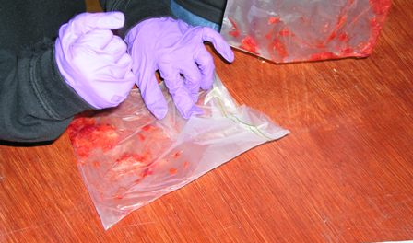
How Do I Begin?
Place the strawberry in a zip lock bag and remove the air
Squash the berry with your hand to begin the process

Slide 13
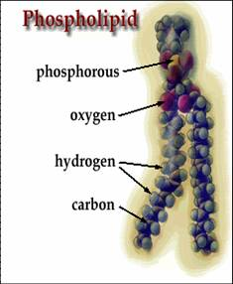
Cell Membrane
Cell membranes are made of phospholipids
Phospholipids won’t dissolve in water
What do you use in your home to remove oils from your hands or your dishes?
SOAP or DETERGENT!

Slide 14
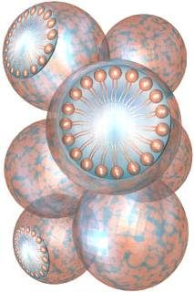
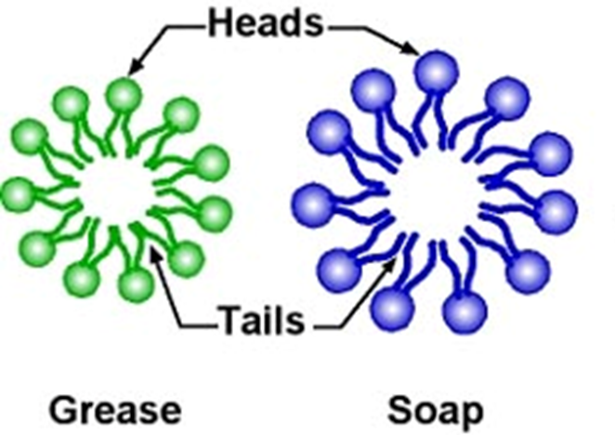
Soap & Detergent
Soap gathers between oil and water capturing the oil in a bubble called a micelle
When you wash your hands, the soap carries the oils away
Dawn dishwashing works BEST to remove phospholipid membranes

Slide 15
Why add detergent?
A cell's membranes have two layers of lipid (fat) molecules with proteins going through them.

Slide 16
Why add detergent?
When detergent comes close to the cell, it captures the lipids and proteins.

Slide 17
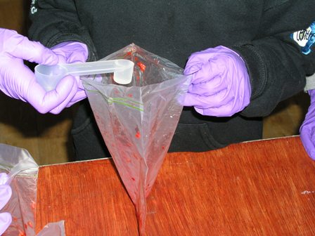
Soap & Detergent
By adding a small amount of table salt (NaCl) to the soap solution, the solution can punch holes in the nuclear and cell membranes
The soapy solution also helps removes proteins

Slide 18
Another Way to Remove Proteins
DNA is tightly coiled around proteins called histones
Proteins must be removed to see DNA
Enzymes, like the ones found in meat tenderizer, can remove protein

Slide 19
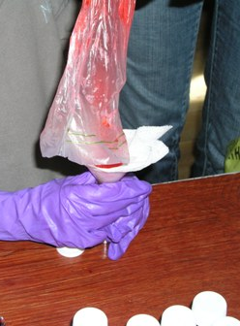
Extracting the DNA
The contents of the cell (organelles, proteins, etc.) must be separated from the DNA
The larger cell parts can be removed by filtering the solid from the liquid

Slide 20
Extracting DNA
To see DNA, it must be extracted or “spooled” from the remaining liquid you filtered
DNA dissolves in water, but NOT in alcohol
Adding COLD ALCOHOL will cause DNA to precipitate (separate out) from the liquid filtrate

Slide 21
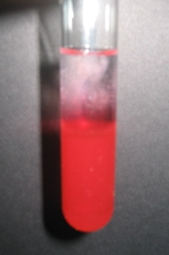
Collecting the DNA
The DNA will appear as a white precipitate once the alcohol is added
HOLD THE TUBE by the TOP, not the bottom so the DNA strands won’t fragment from the heat of your hands!

Slide 22
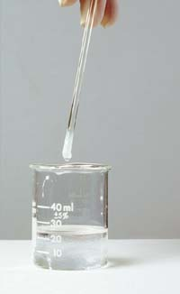
Spooling the DNA
DNA is sticky and will adhere to other surfaces
A glass stirring rod can be used to spool (remove) the DNA by using a turning motion

